Slide 1
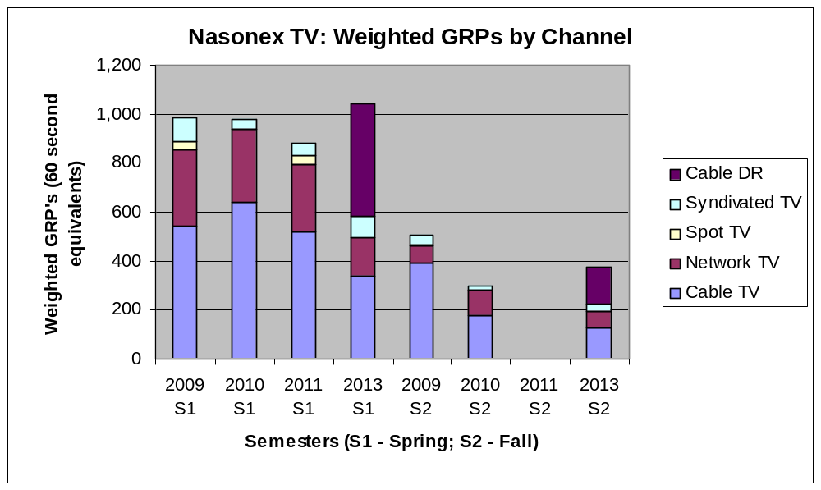
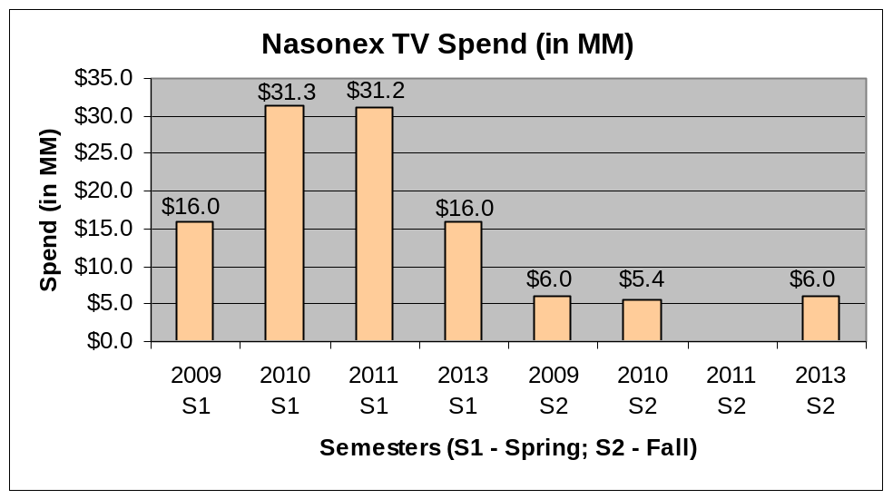
Comparison of TV ads between 2009, 2010, 2011 Spring and 2013 (projected)
2013 has heavy Cable-DR component with lower spend in spring.
Previous Nasonex TV analysis had study period between Aug-2009 to Jul-2011.
The Spring total GRPs in weighted scale (i.e., 60 second equivalents) are more or less similar between 2009, 2010, 2011 and 2013.
Spend for Spring 2013 is almost ½ of Spring of 2011. Heavy “Cable – DR” in 2013 to increase the GRP with lower spend.
Spend in Fall is more or less constant across years (note: 2011 fall was not included in the chart). However, “Cable-DR” is a heavy component for 2013 Fall.
Given the differences in channel GRP distributions across years, the impacts per GRP may be different in 2013, but we do not know how much.
  If we assume that the impact per GRP is same like before, then the Spring 2013 ROI may double (from 1.5 to 3.0) since the spend is reduced by 50%.
  Given the unknowns, a safer assumption may be that ROI’s may be similar as before (instead of impact per GRP being same) and make projections on incremental revenue.
2011 Fall data
is missing
Study Period: Week ending 17-June-2011 to 30-Mar-2012 (42 weeks).

Slide 2
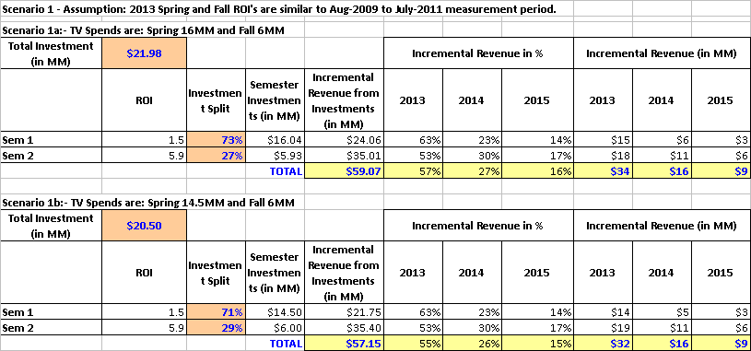
Projected Incremental Revenue from 2013 TV campaign
Assumption: ROIs will be similar as before.
Scenario 1a with 16MM Spring and 6MM Fall TV spend may generate $59MM ($34MM in 2013)
Scenario 1b with 14.5MM Spring and 6MM Fall TV spend may generate $57MM ($32MM in 2013)
Previous Nasonex TV analysis had study period between Aug-2009 to Jul-2011.
Minimum possible spends specified by GMC team was: Spring 14.5 MM and Fall: 6MM
Study Period: Week ending 17-June-2011 to 30-Mar-2012 (42 weeks).

